Slide 1

A Novel Safe Merging Algorithm for Connected Vehicles Using NetLogo

Slide 2

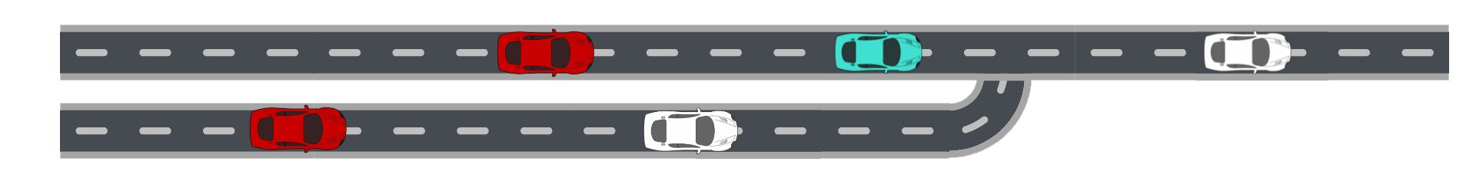
THE CONTEXT
One main lane
One secondary merging lane
THE GOAL
Safe traffic
Safe merging

Slide 3

IMPLEMENTED ALGORITHMS:
Vehicle tracking algorithm
Merging control algorithm

Slide 4

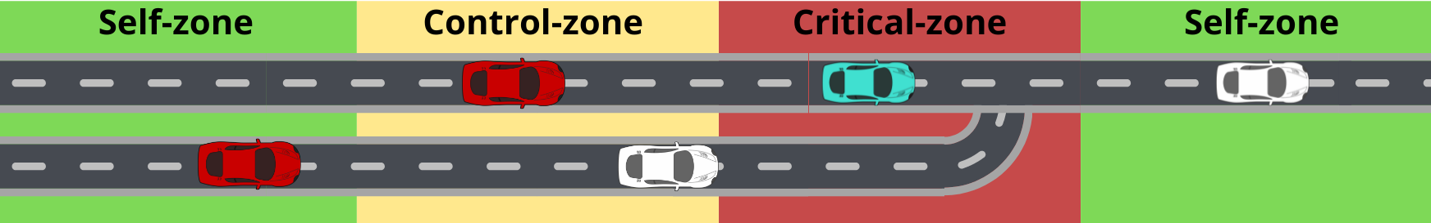
IMPLEMENTED ALGORITHMS:
The street is divided into different zones:
Vehicle tracking algorithm observed in all zones
Merging control algorithm observed in control zone

Slide 5

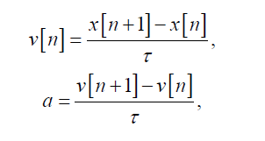
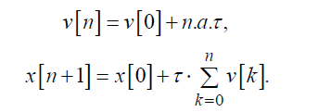

Vehicle tracking algorithm (1)
We start from the definitions of velocity and acceleration in a discrete system:
and accordingly we can update the speed and position of the vehicles in this way:
By combining these two equations we can rewrite the position update as follow:
The key point for a safe tracking is that Δx between successive vehicles has to be greater than Δxmin for all times. So if the leading vehicle makes its speed lower or it stops, the following one has to change its speed accordingly in order to prevent any collisions.

Slide 6
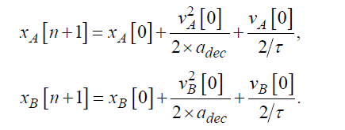
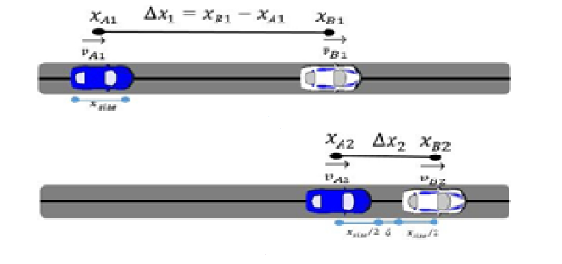

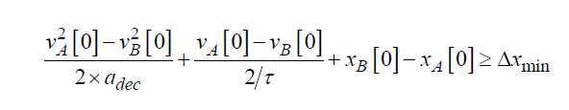
Vehicle tracking algorithm (2)
So we consider two successive vehicle A->B. Assume that both vehicles stop for final case.
Since vehicles speed of each one will be zero for the final condition, the equation of the position can be rewritten
for each vehicle as follows:
And combining them with the safe traffic flow equation:
We obtain the condition thath must be ensured for all time:

Slide 7

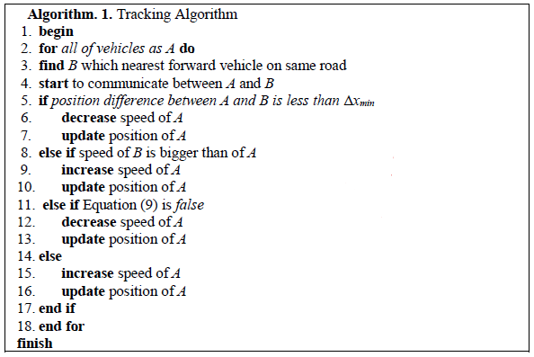
Vehicle tracking algorithm (3)
With this speed, can I stop myself ensuring the minimum
distance between me and the successive vehicle?

Slide 8
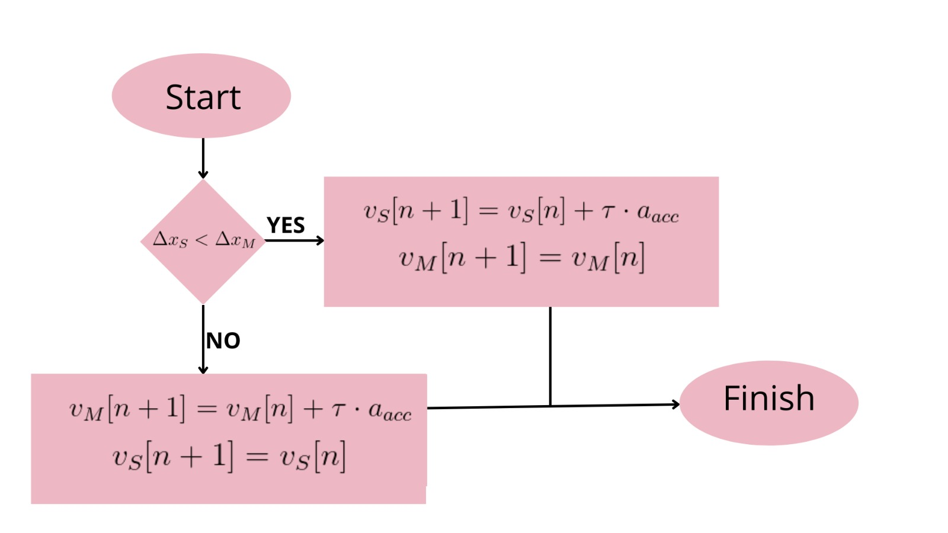
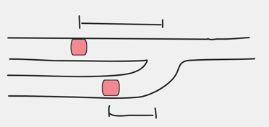
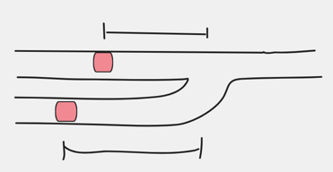
Merging control algorithm
A vehicle on the secondary lane seeks a vehicle on the main lane in order to associate itself with him.
Associated vehicles are lined up by increasing or decreasing their speed before the critical zone.
In this way the secondary vehicle can merge to the main road before or after the companion vehicle safely.
Companion vehicles have to obey the following merging algorithm:
ΔxM
ΔxS
ΔxM
ΔxS
ΔxM → distance between the position of the car on the main lane and the merging point
ΔxS → distance between the position of the car on the secondary lane and the merging point

Slide 9
IMPLEMENTATION

Slide 10
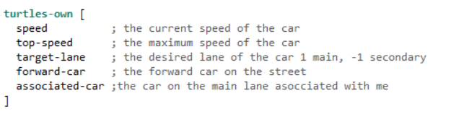
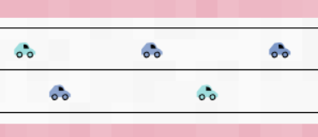
Implementation (1)
Agent structure:

Slide 11
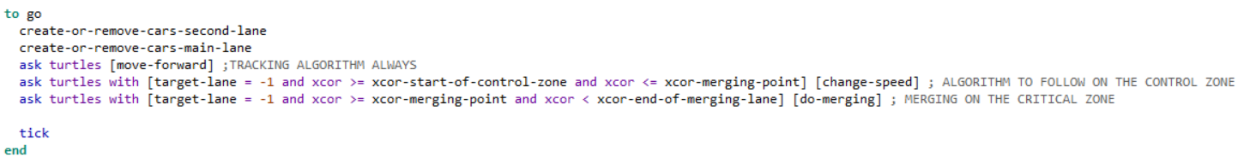
Implementation (2)

Slide 12
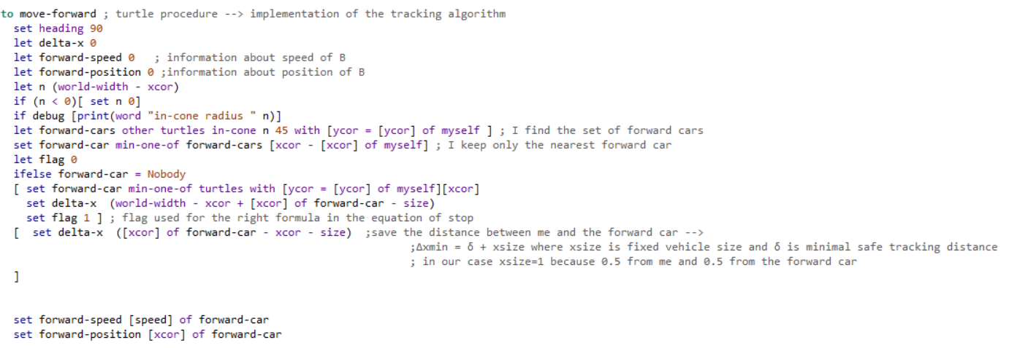
Vehicle tracking algorithm Implementation (1)
All cars have to find their forward car in order to adjust their speed accordingly.
Procedure to find the forward car:

Slide 13
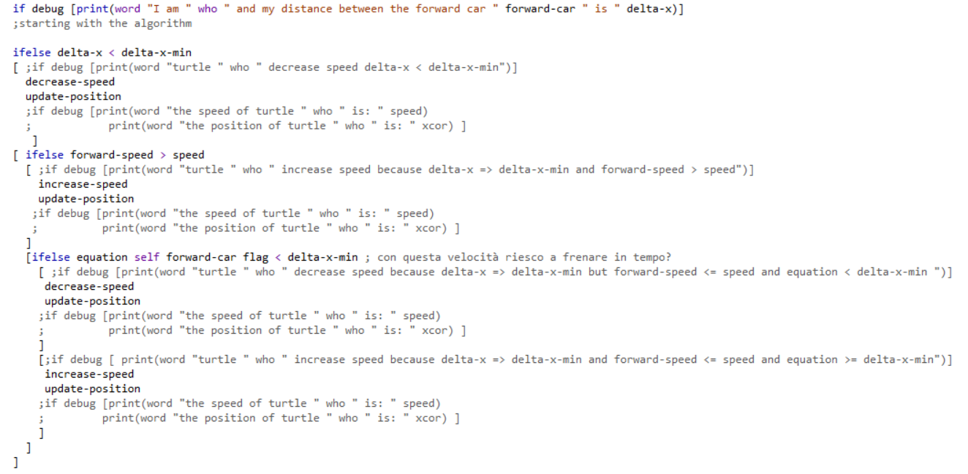



Vehicle tracking algorithm Implementation (2)

Slide 14



Vehicle tracking algorithm Implementation (3)

Slide 15
Vehicle tracking algorithm Implementation (4)

Slide 16
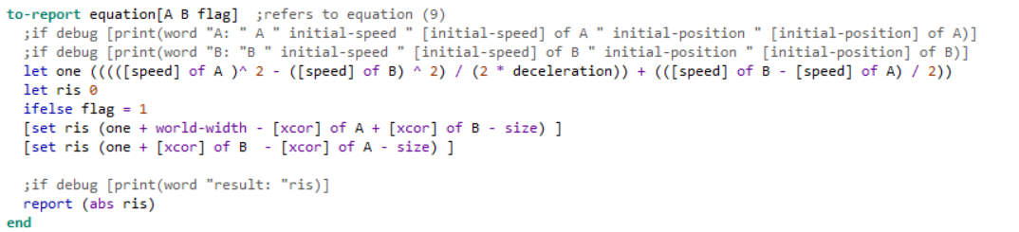
Vehicle tracking algorithm Implementation (5)

Slide 17

Merging control algorithm Implementation (1)
Changes in the algorithm in order to avoid speed saturation:

Slide 18
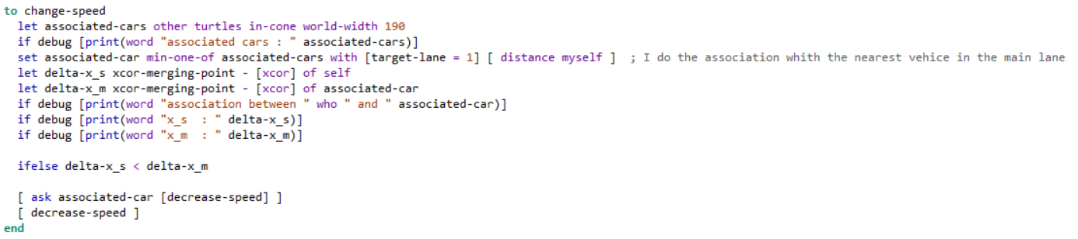
Merging control algorithm Implementation (2)
Procedure to find the associated car in the main lane

Slide 19
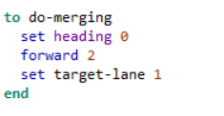
Merging control algorithm Implementation (3)
Nel merging point

Slide 20

SIMULATION

Slide 21
Simulation (1)
Parameters:
aacc = 0.005
adec = 0.15
τ= 1
Δxmin = 6
Top-speed = 0.5
Max initial number of cars on main lane = 8
Max initial number of cars on secondary lane = 3

Slide 22

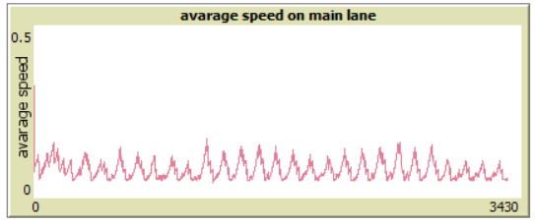
Simulation (2)
Main 8
Second 3

Slide 23
Simulation (3)

